Slide 1

AgriTech IoT
By Team Insight
In Collaboration with Centre for Technology Infusion

Slide 2

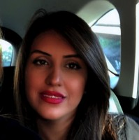
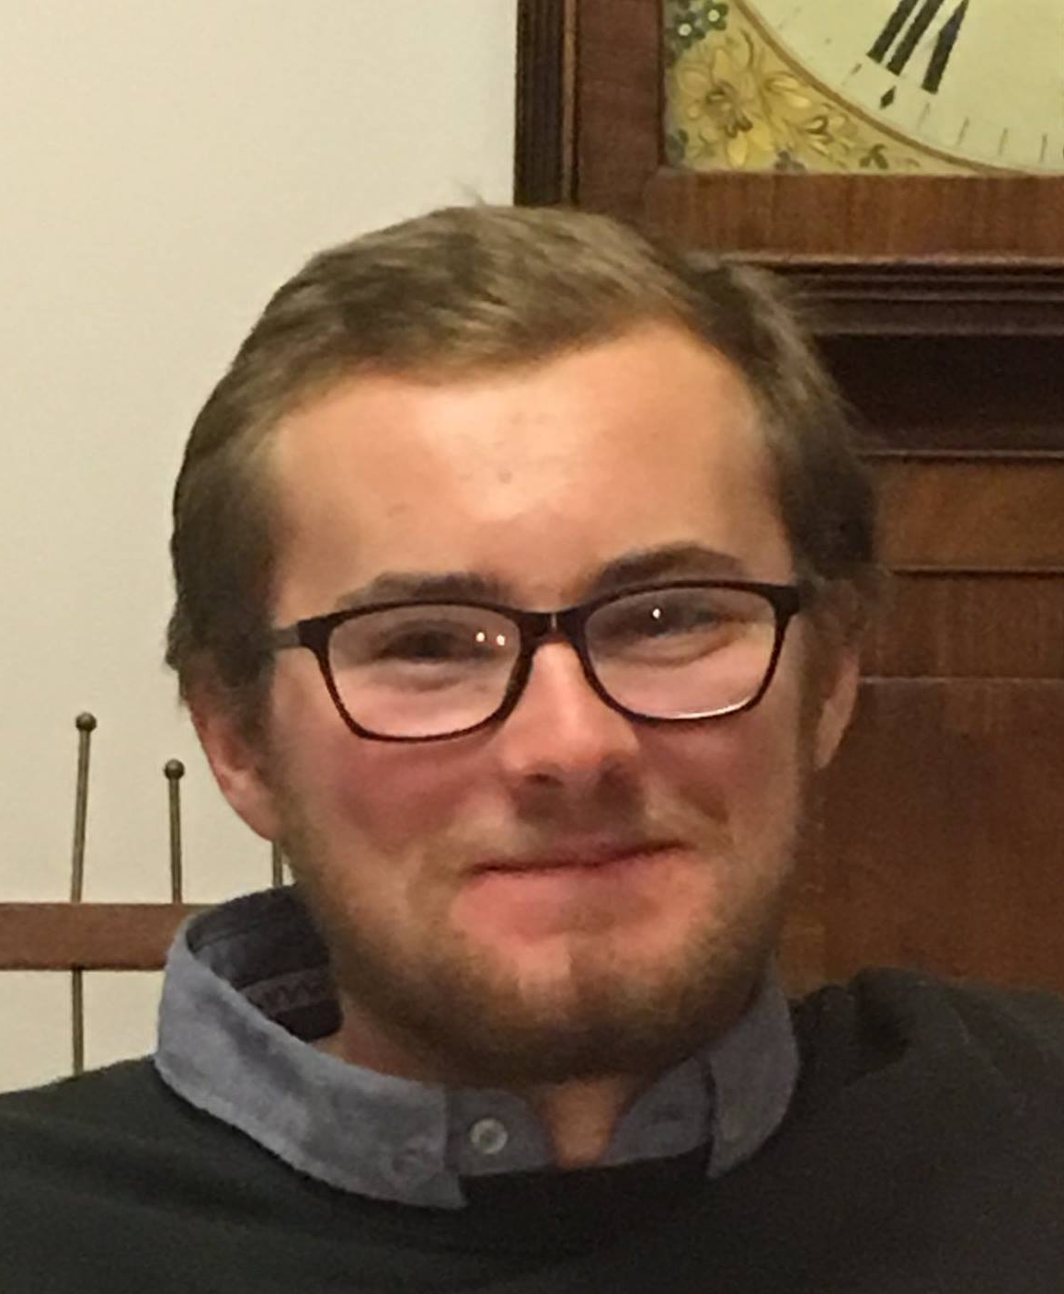
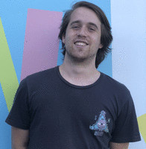
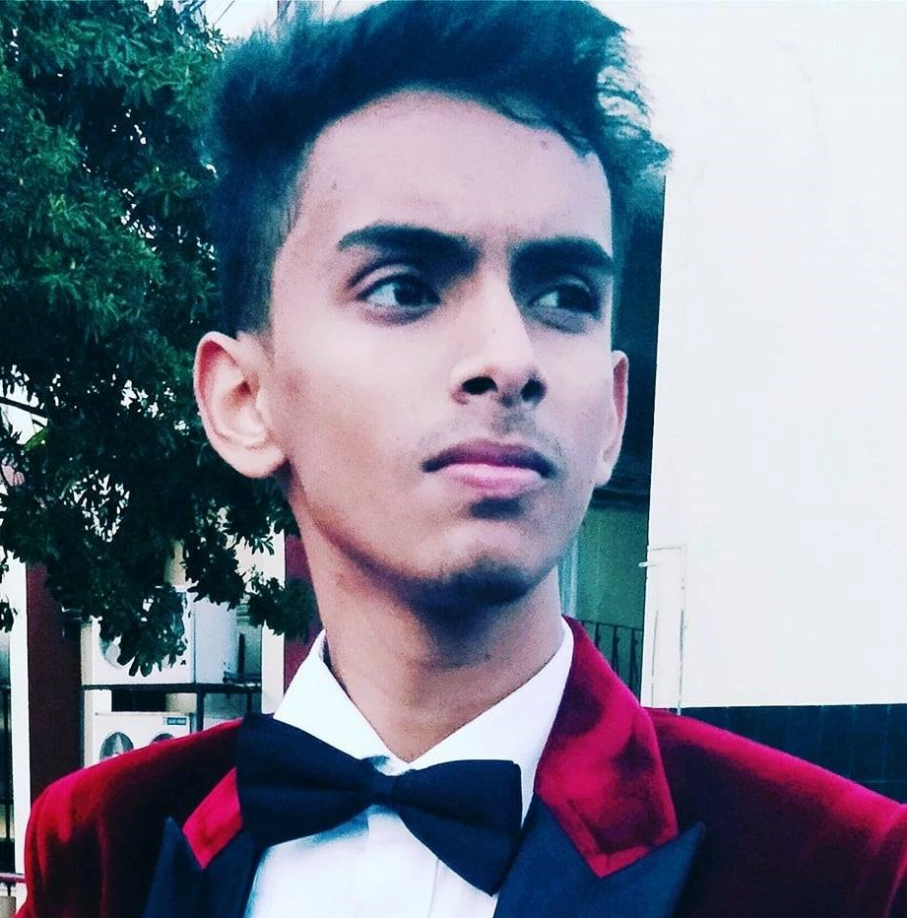
About our Team
M Alicia Hadisaputra – LoRaWan Gateway & Cloud administrator, Team Assistant
Mona Abedi – Machine Learning & Database administrator, Team Leader
Liam Maguire – Frontend developer/designer
David Wisniewski – Hardware developer
Milind Rajpoot– Hardware developer

Slide 3
Outline
Project Overview
constraints
Sprint Implementation
Implementation
Areas of Improvement
Project Solution
Sensors
LoRaWAN Gateway
Dashboard
Problem Domain
System Architecture
Machine Learning

Slide 4
The problem
30 million sheep in Australia alone
Farmers have no efficient way of monitoring the health of livestock
Solutions provided so far are expensive

Slide 5
PROJECT REQUIREMENTS
Retrieval of data from sensors attached to animals
Retrieve data via LoRaWAN
Train data with machine learning algorithms
Store data within a database
Display data in an easy to understand manner

Slide 6
Constraints
Lack of face to face interactions
Inability to implement LoRaWAN as required

Slide 7
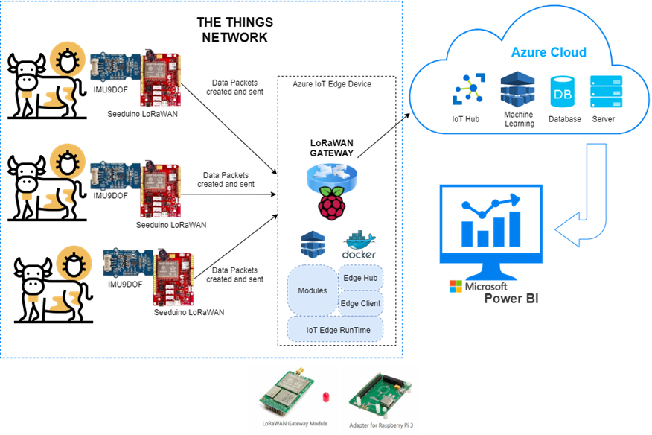
SYSTEM ARCHITECTURE

Slide 8
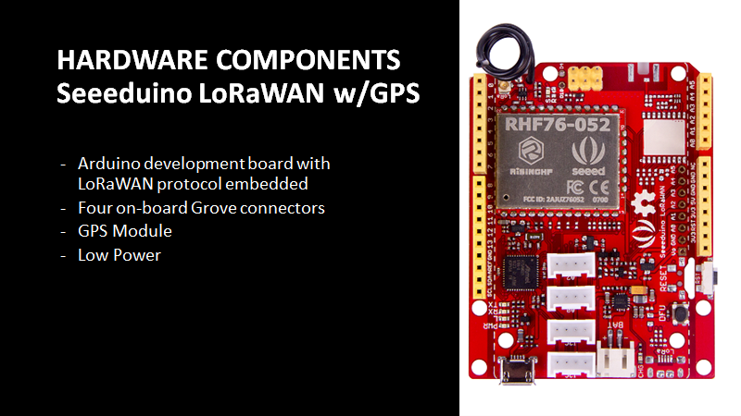

Slide 9
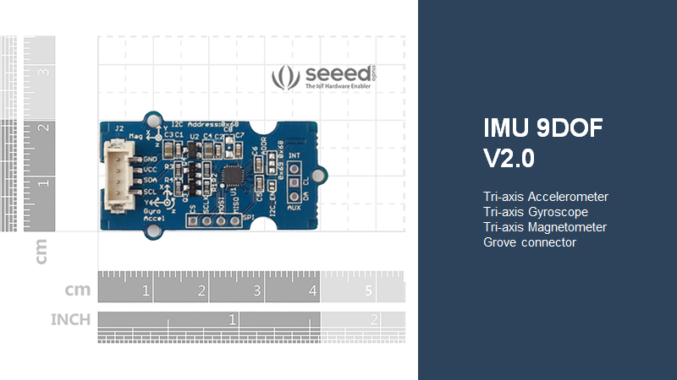

Slide 10
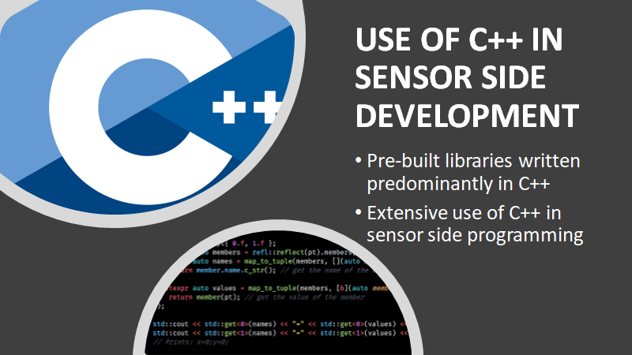

Slide 11
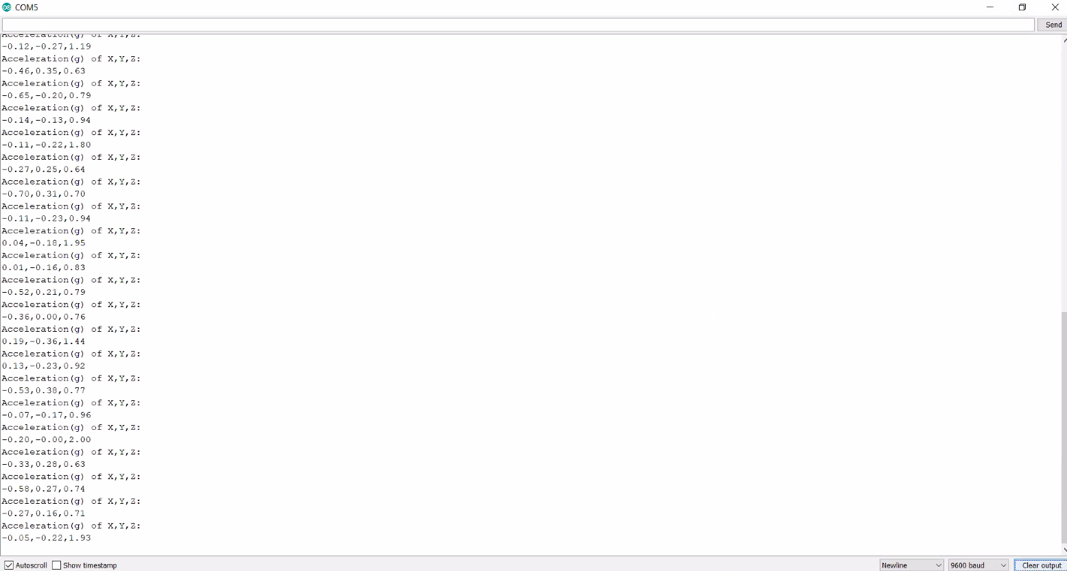
DATA RETRIEVAL

Slide 12
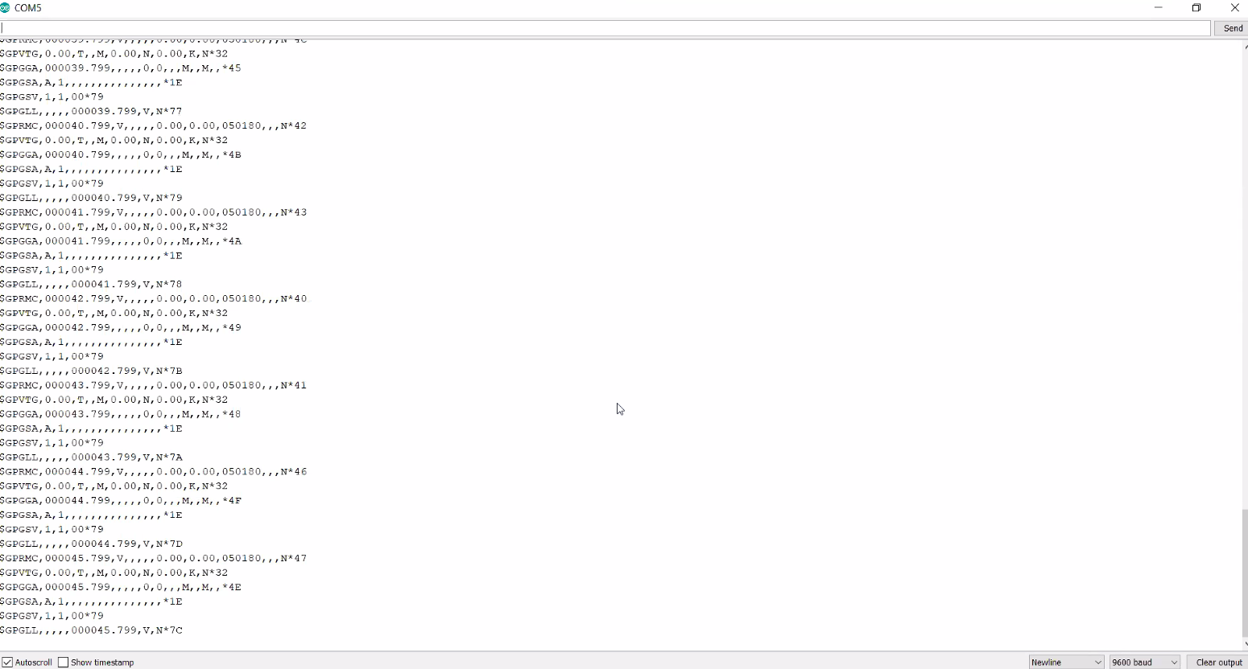
DATA RETRIEVAL​

Slide 13
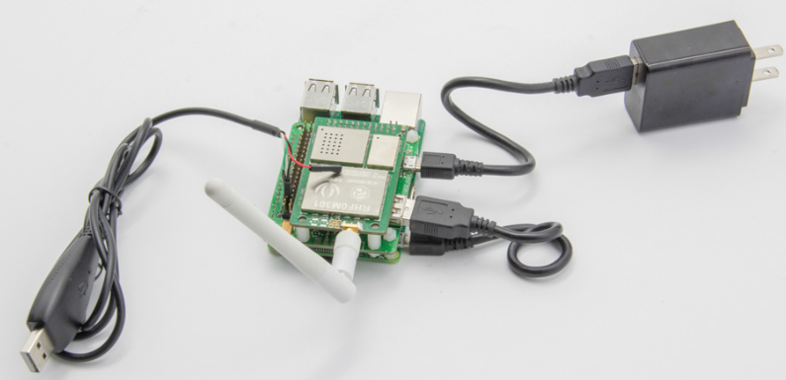
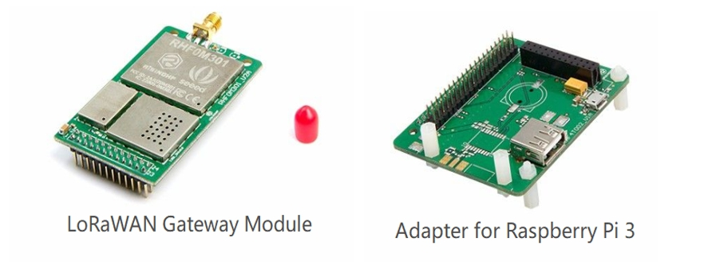
LoRaWan Gateway

Slide 14
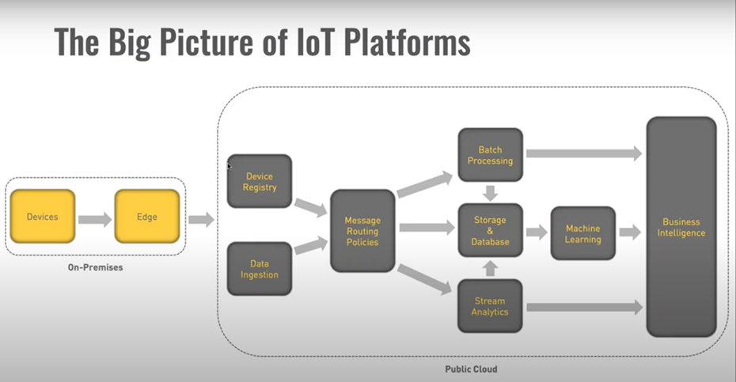
End nodes -> Gateway

Slide 15
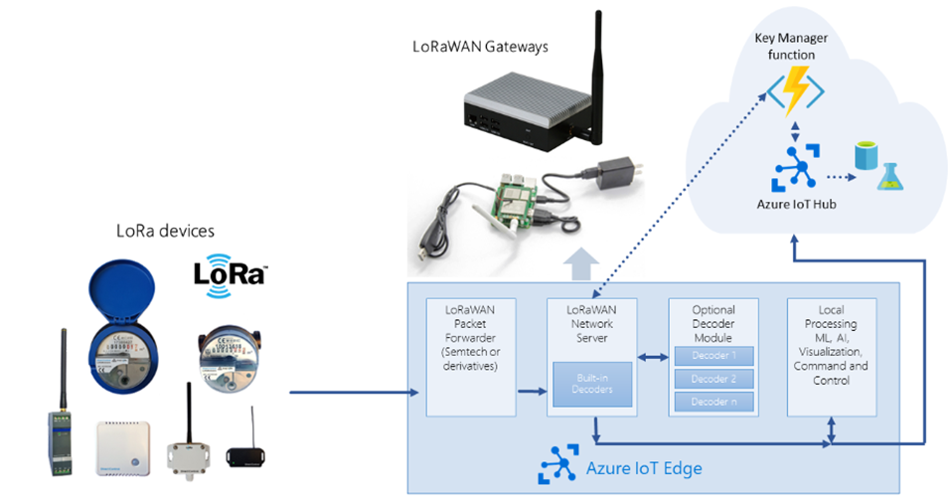
Why Azure IoT Edge?

Slide 16
Why Azure IoT Edge?

Slide 17

IoT Edge Benefit
Reduce latency
Increased data security
Reduce cost

Slide 18
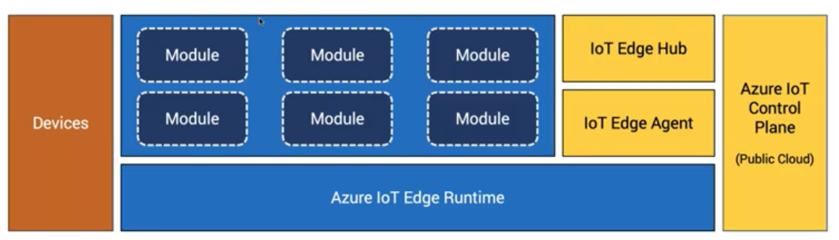
IoT Edge Architecture
Modules we are running on the gateway:
LoRaWanNetworkServer
LoRaWanPacketForwarder
Machine Learning Model

Slide 19
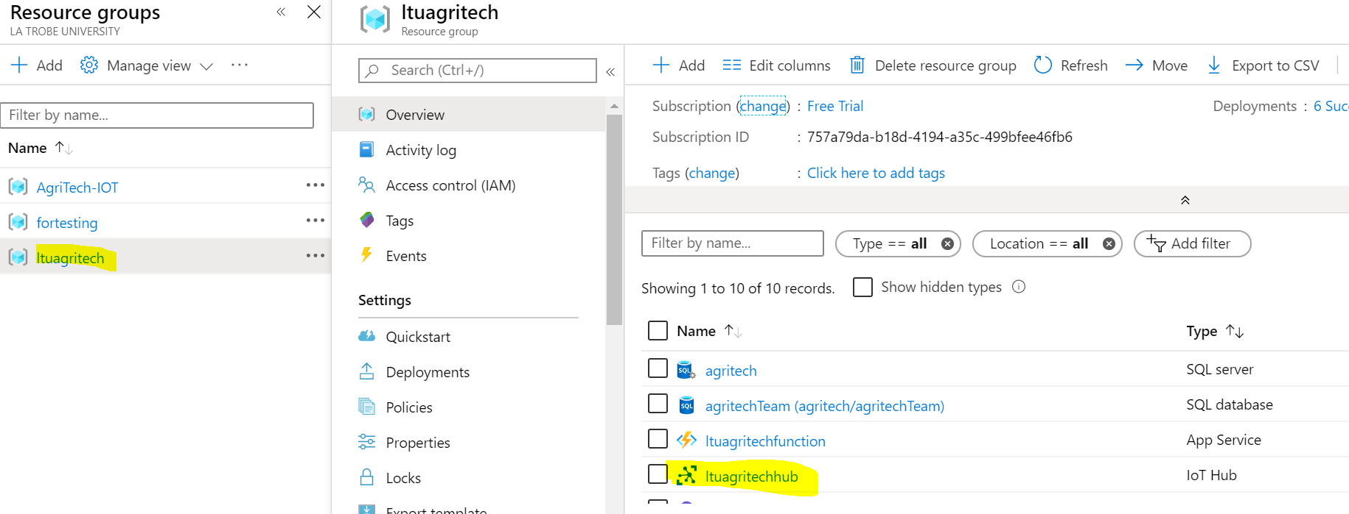

Slide 20
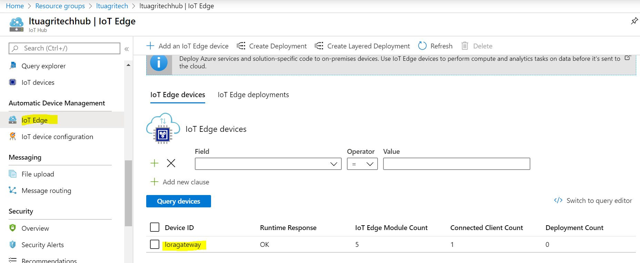

Slide 21
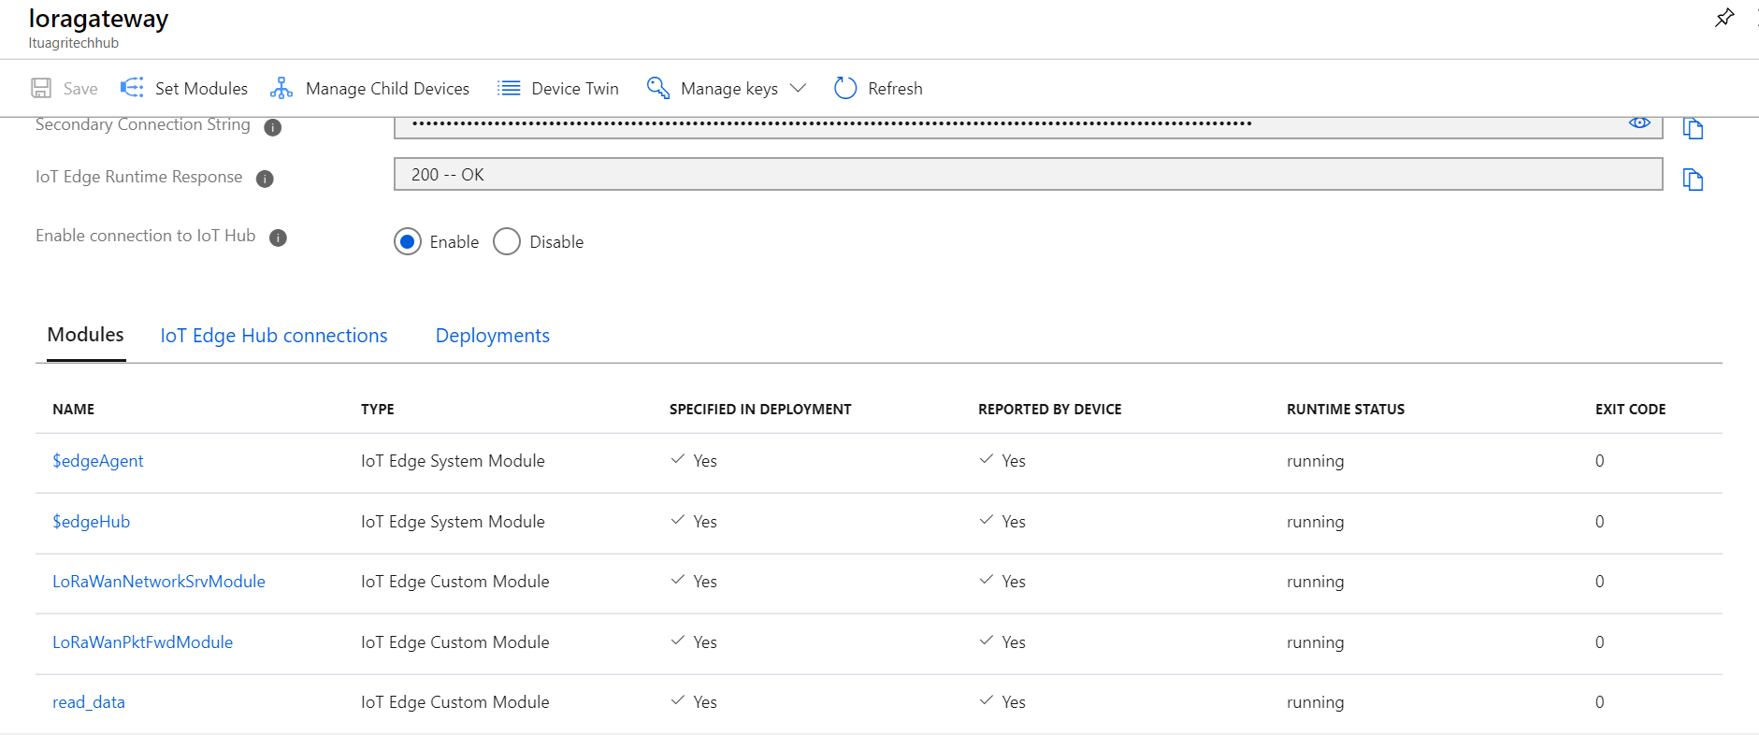

Slide 22
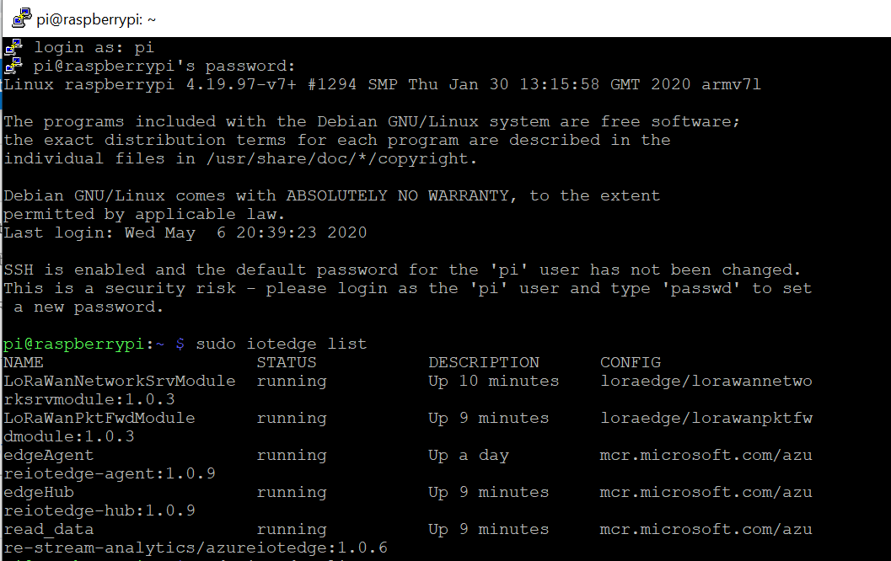

Slide 23
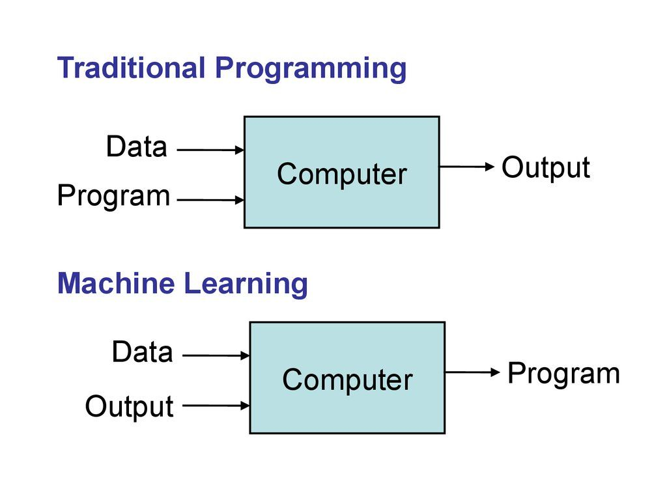
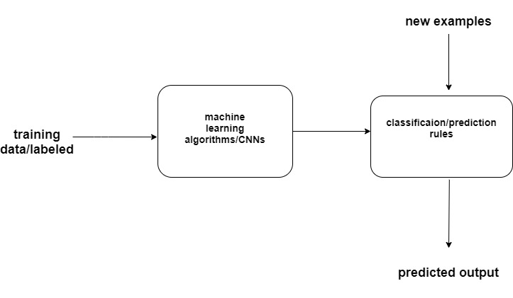
Typical ML Approach

Slide 24

Animal Recognition Activities:
Walking
Grazing
Idle
Rumination
Licking
The activity recognition is the problem of predicting the movement of an animal. based on sensor data, such as an accelerometer

Slide 25
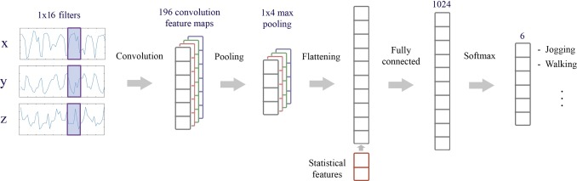
Convolutional Neural Network
Convolutional Neural Network models, or CNNs for short, are a type of deep neural network that were developed for use with image data, e.g. such as handwriting recognition.
CNNs contains 2 main type of element:
Convolutional layer
Pooling layer
CNNs can be applied to human/animal activity recognition data

Slide 26
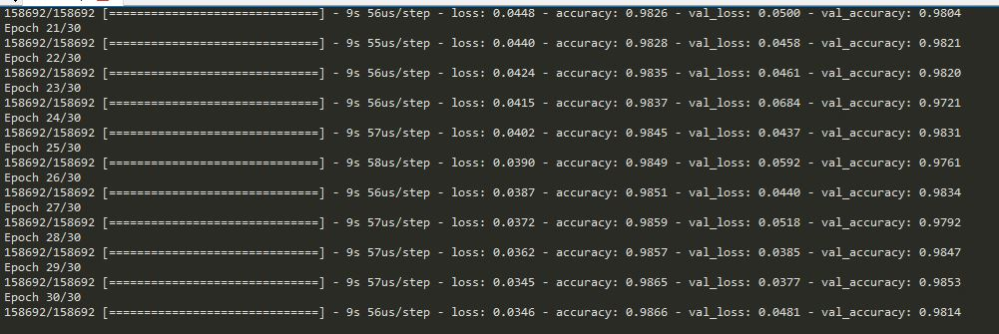
Measuring Accuracy:
The training dataset was split into train (80%) and test (20%)- best fit model

Slide 27
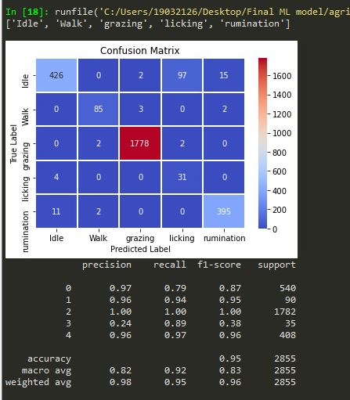
Testing data Accuracy and confusion Matrix
Idle animals -----> 426 idle animals are classified correctly and 97 of idle animals classified licking and 15 idle animals classified in rumination class which is not correct

Slide 28
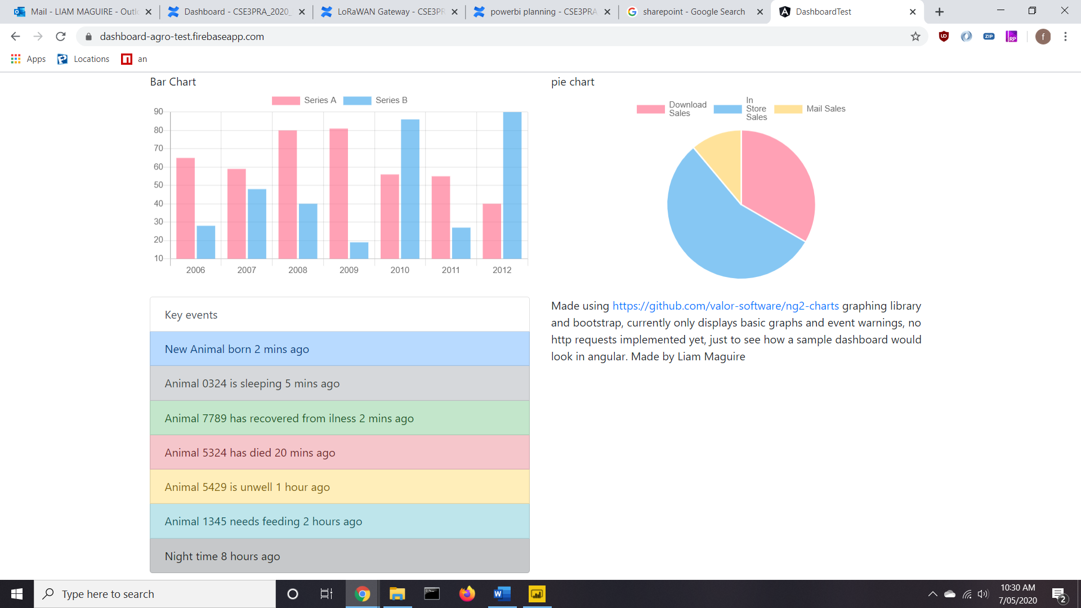
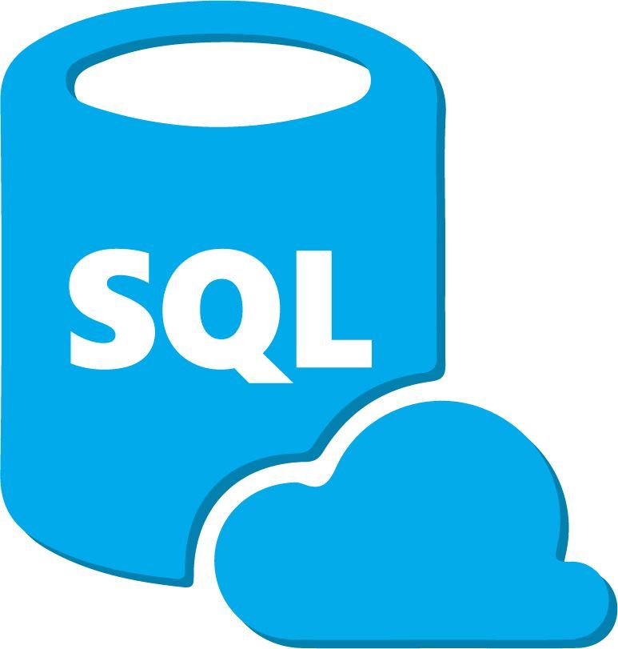
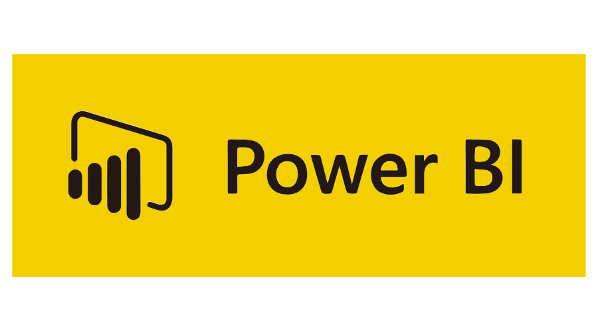
LoRaWan Gateway
Power BI
DashBoard

Slide 29
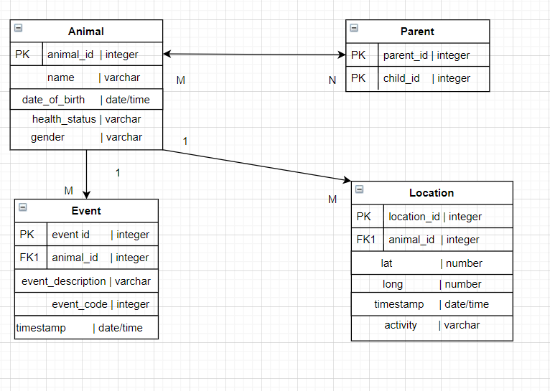

Slide 30
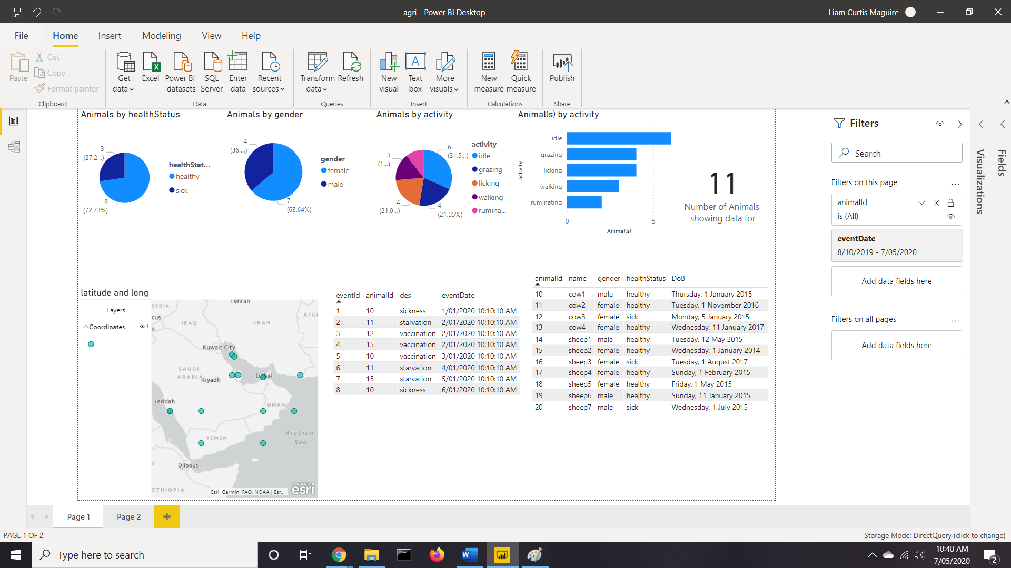

Slide 31
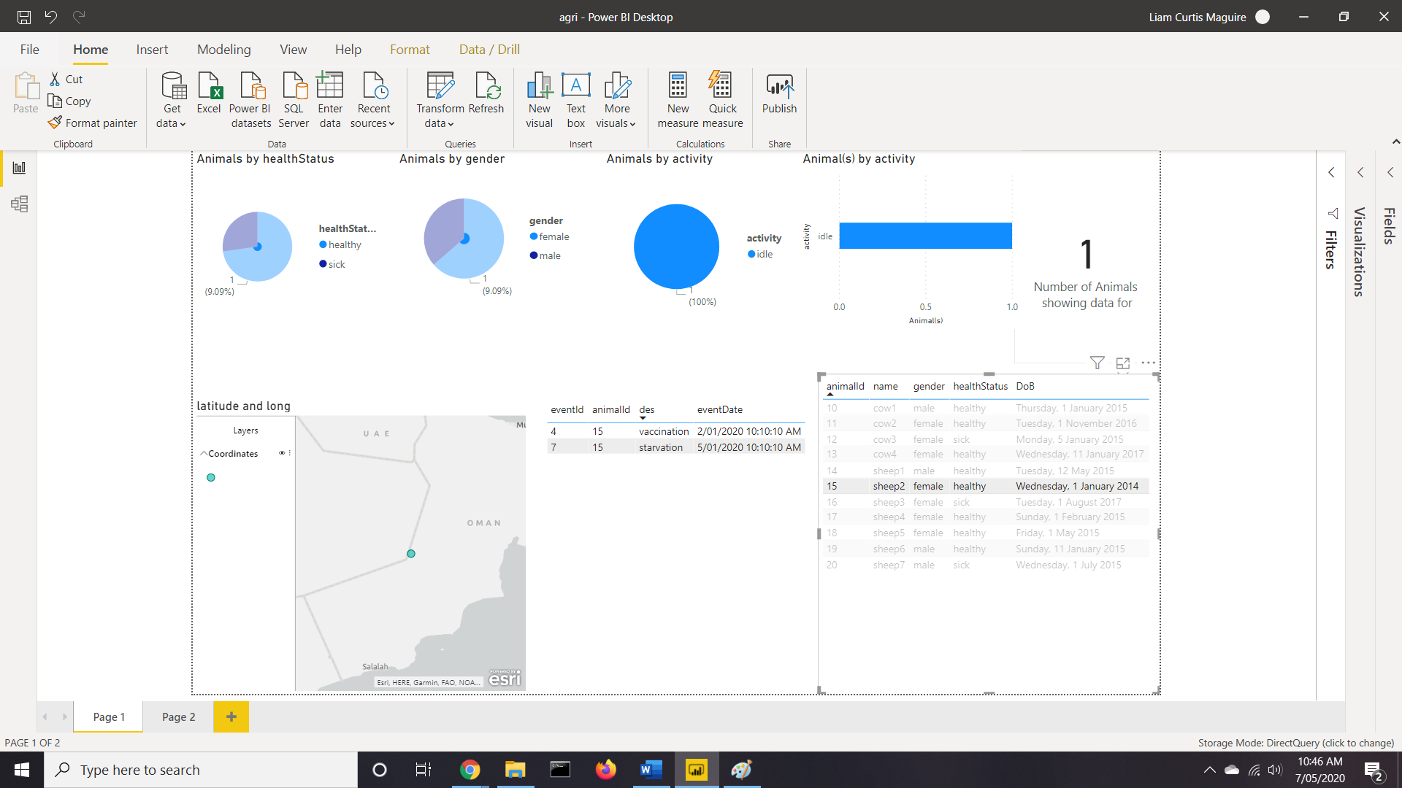

Slide 32
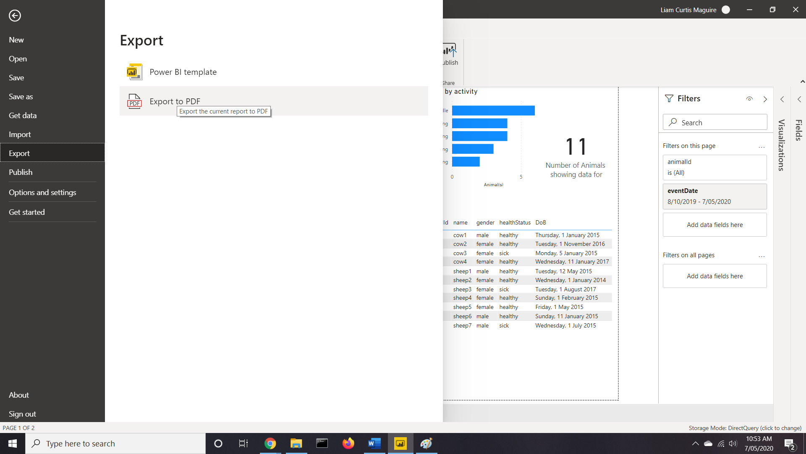

Slide 33
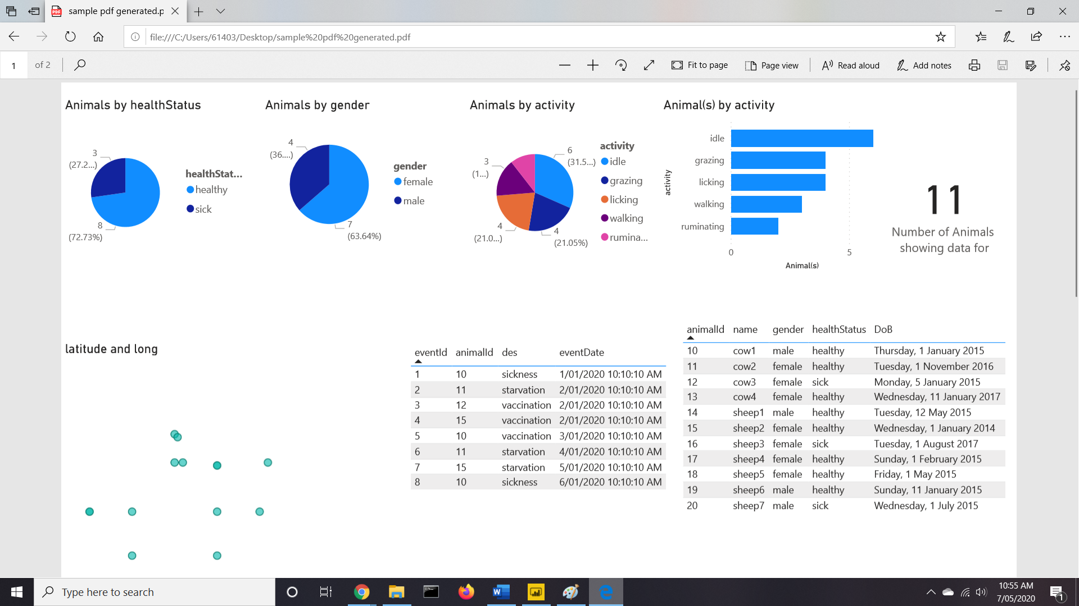

Slide 34
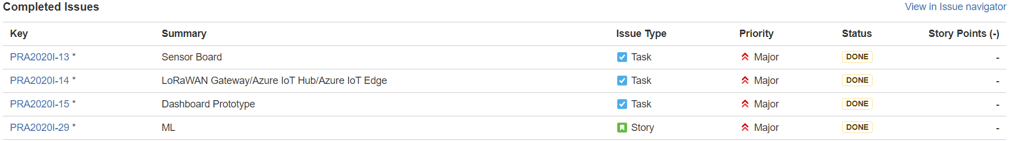
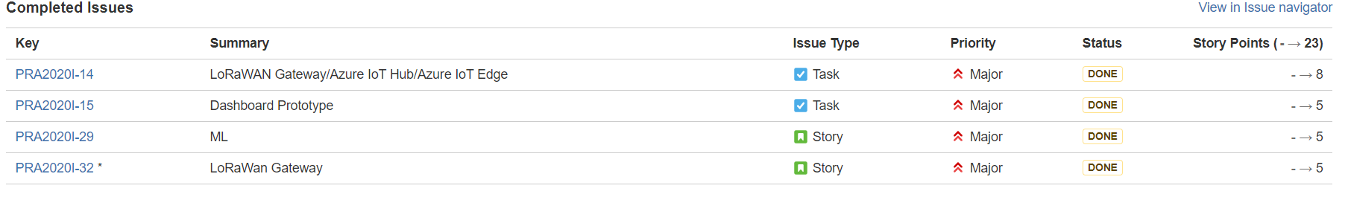
Improvements
Sprint 1
Sprint 2
Sprint 3

Slide 35
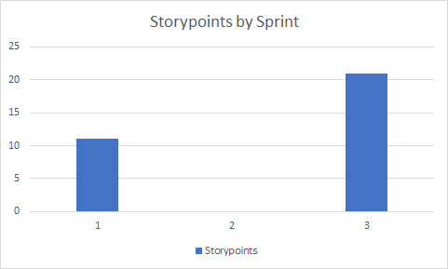
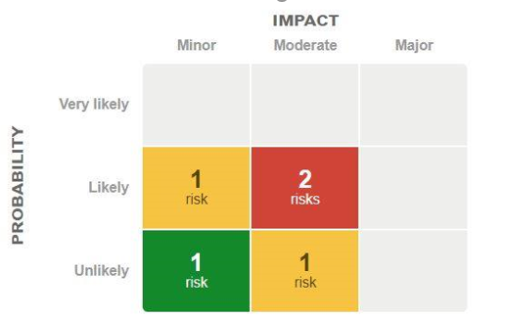
Metrics

Slide 36
Going forward
sprint 5 goals
Sending - retrieving data via TTN
Final Presentation
Working prototype
Heading into Semester 2
Final build with custom hardware

Slide 37
Q&A

